Slide 1
Proposed Definition for “Engagement in Public Speaking”
“Engagement in public speaking is the oral presentation of an organized, supported message to a specific audience, conducted either in person technologically mediated. For the purposes of this definition, ‘oral’ encompasses communication via sign language or assistive technology.”
SECTION 1
Definition will be displayed:
On the General Education – State Core Requirements page, demonstrating compliance with new BOG Regulation for use in State Core Communication Syllabuses

Slide 2
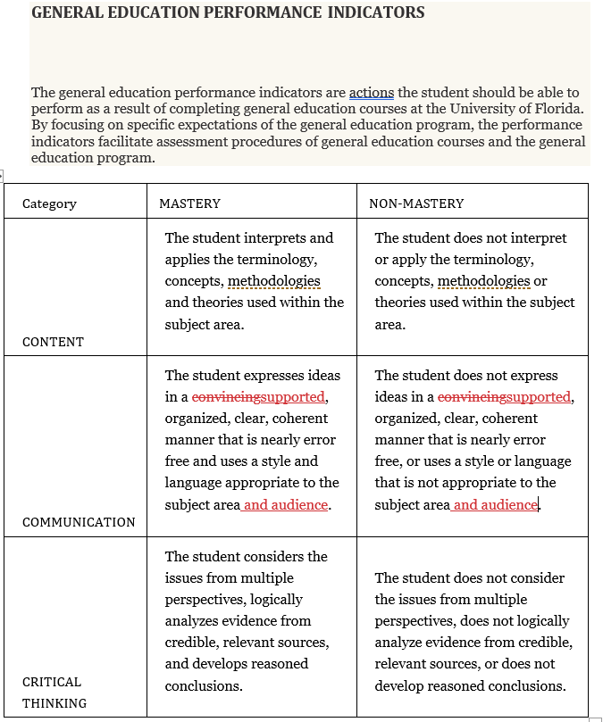
Proposed Modification to Performance Indicator (Mastery/Non-Mastery)
SECTION 2
Notes:
No change to Communication Institutional SLO is required since oral and written communication are already stated.
Proposal to change this page: https://undergrad.aa.ufl.edu/general-education/gen-ed-courses/structure-of-gen-ed-courses/slos-and-performance-indicators/performance-indicators/

Slide 3
Proposed Requirement for SLO in State Core Communication
Beginning Fall 2024, each State Core Communication course must include an SLO for engagement in public speaking that is assessed in one or more assignments in the course.
SECTION 3
Notes:
It is recommended to display the definition for “Engagement in Public Speaking” from the first slide
The definition allows for faculty discretion while meeting the intent of the BOG regulation
BOG can view compliance from State Core syllabus archive page.

Slide 4
Future Direction for Communication Sub-Committee
Since this meets the intent of introducing Public Speaking, but does not include all essential facets, the GEC might consider an additional General Education category for Public Speaking or micro-credentials to string together courses that focus on critical components of public speaking
SECTION 4
Notes:
Potential “badging” recognized by the GEC for Public Speaking for course and non-course participation.
A General Education category like International or Diversity might be considered for Public Speaking
If multiple courses are involved, a Public Speaking Certificate might be considered

